Slide 1


NEARBY Platform for Automatic Asteroids Detection and EURONEAR Surveys
ESA NEO and Debris Detection Conference - Exploiting Synergies
ESA/ESOC, Darmstadt, Germany, 22 - 24 January 2019
Dorian Gorgan¹, Ovidiu Vaduvescu²
¹Technical University of Cluj Napoca, Romania
²Isaac Newton Group, La Palma, Canary Islands, Spain;
Instituto de Astrofisica de Canarias, Tenerife, Canary Islands, Spain; University of Craiova, Romania
dorian.gorgan@cs.utcluj.ro; ovidiu.vaduvescu@gmail.com

Slide 2
Overview
NEARBY Platform
Asteroids detection algorithms
Asteroids detection application
EURONEAR and NEARBY pilot surveys
Issues on data acquisition, processing and analysis
Conclusions and future works

Slide 3
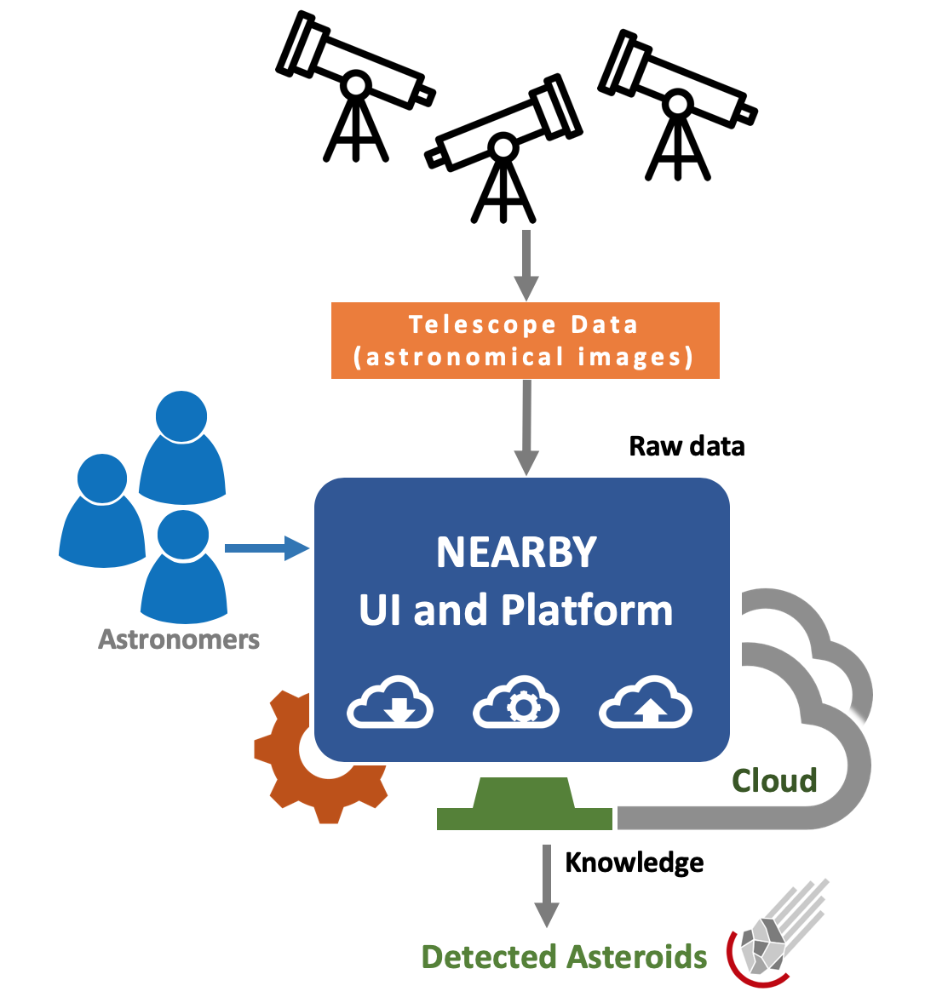
NEARBY Conceptual System

Slide 4



NEARBY Project
NEARBY Project (Visual Analysis of Multidimensional Astrophysics Data for Moving Objects Detection)
Funded by the Romanian Space Agency (ROSA)
Contract: 192/2017 (2017-2019)
Partners:
  Technical University of Cluj-Napoca
  University of Craiova, Romania
Use case and data providers:
  Isaac Newton Group, La Palma, Canary Islands, Spain;
  Instituto de Astrofisica de Canarias, Tenerife, Canary Islands, Spain

Slide 5
Objectives
Software platform and application
Process and analyze multidimensional data
Detect and identify faint moving objects in astronomical images within short time intervals
Visually analysis and validation of the moving objects
Flexible description of the adaptive processing over high performance computation infrastructure

Slide 6
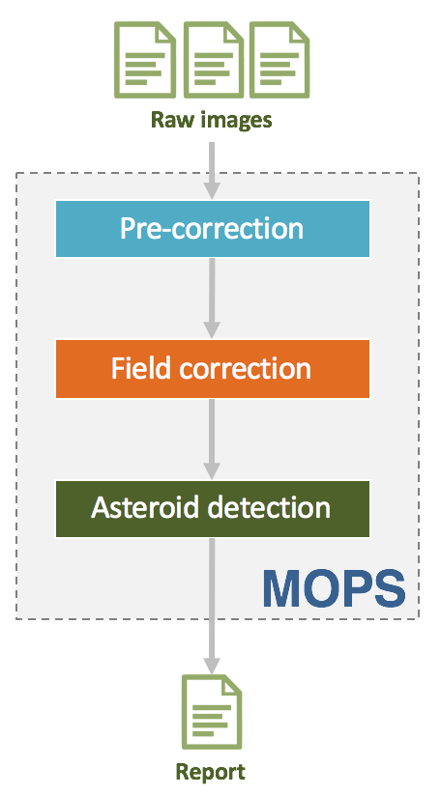
Asteroids Detection Application (MOPS)
Based on the classical blinking moving detection
Pre-correction
  corrects artifacts (bias and flat field) and bad pixels from the raw input
Field correction
  corrects the field distortions and resamples the raw images
Asteroid detection
  identifies asteroids trajectories

Slide 7
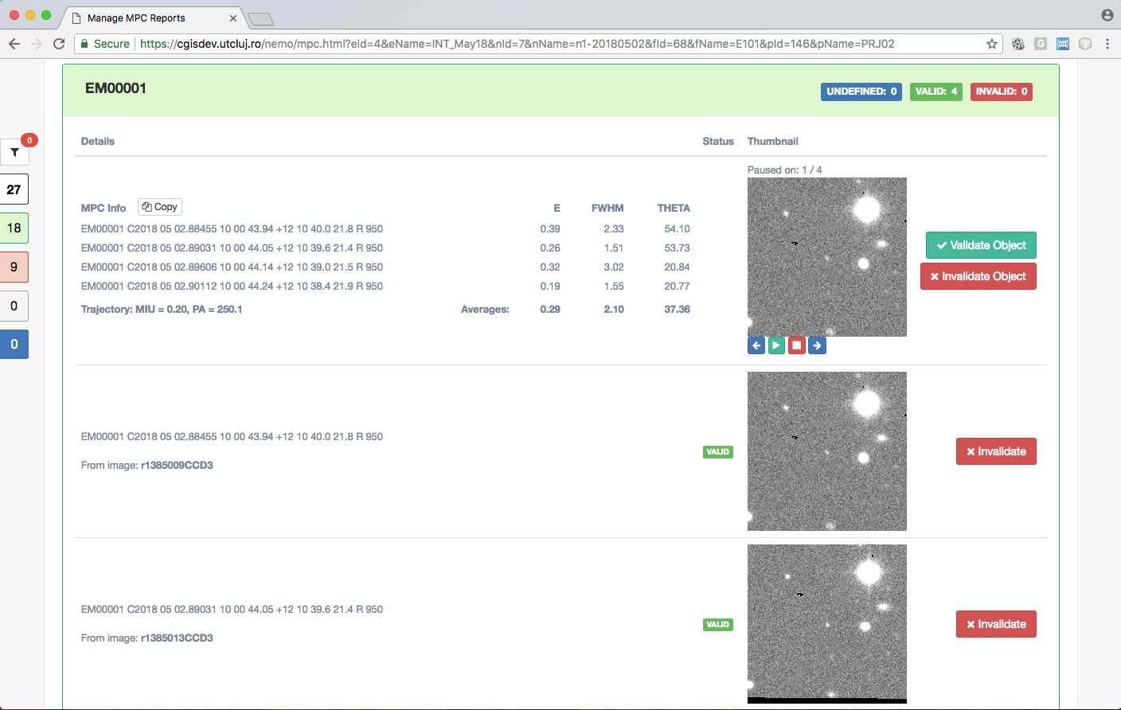
NEARBY Application – User Interface

Slide 8
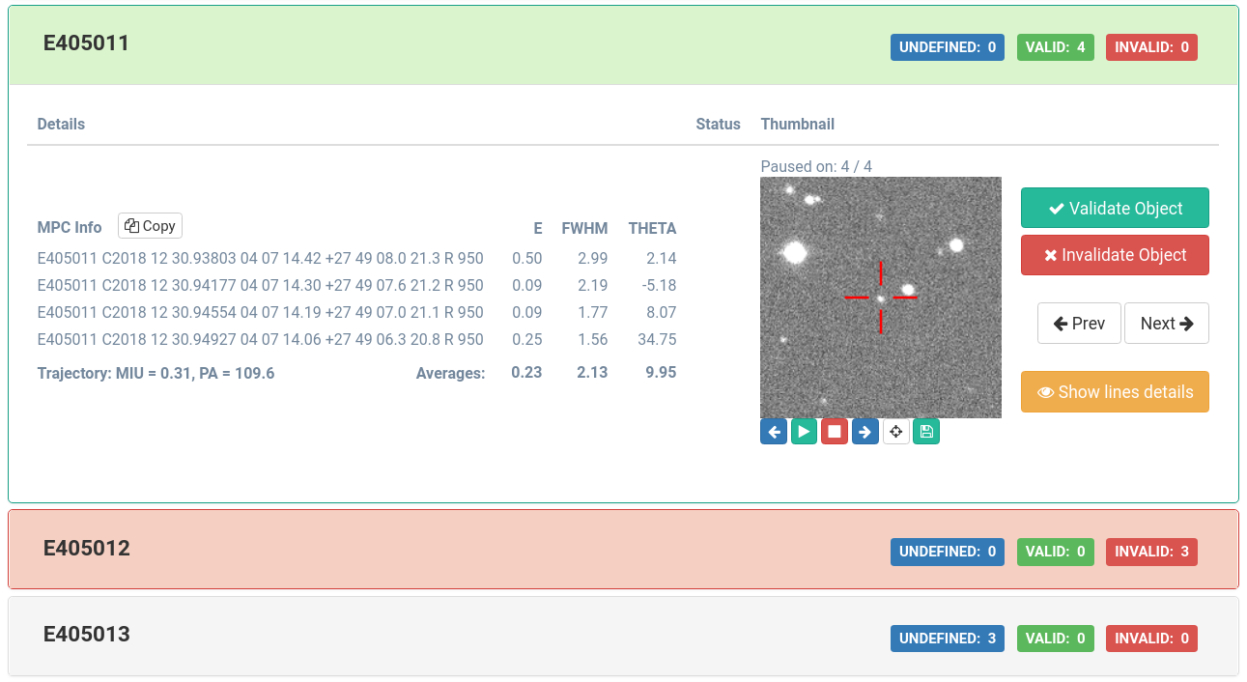
NEARBY Application – User Interface

Slide 9
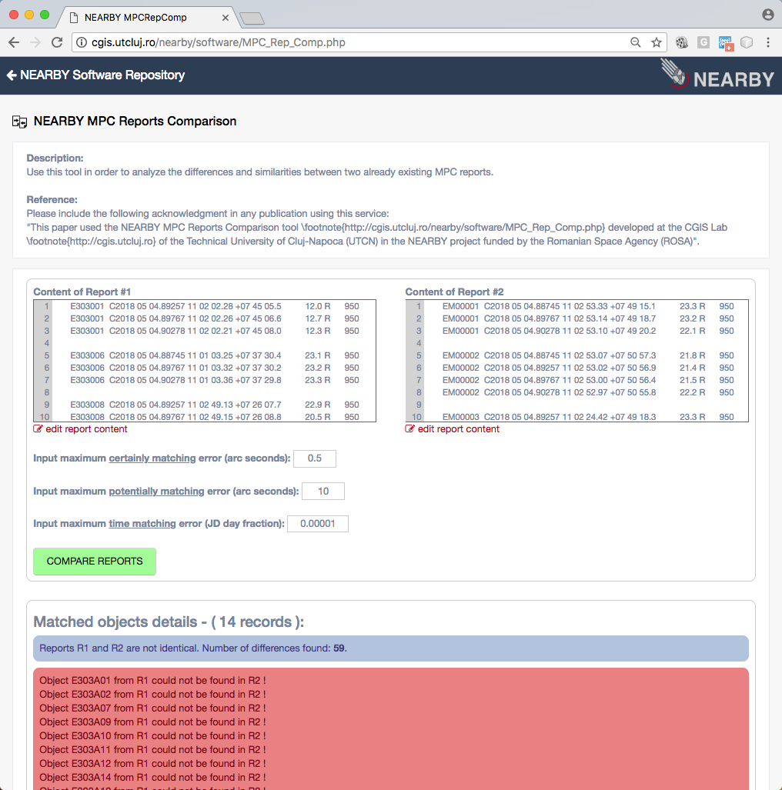
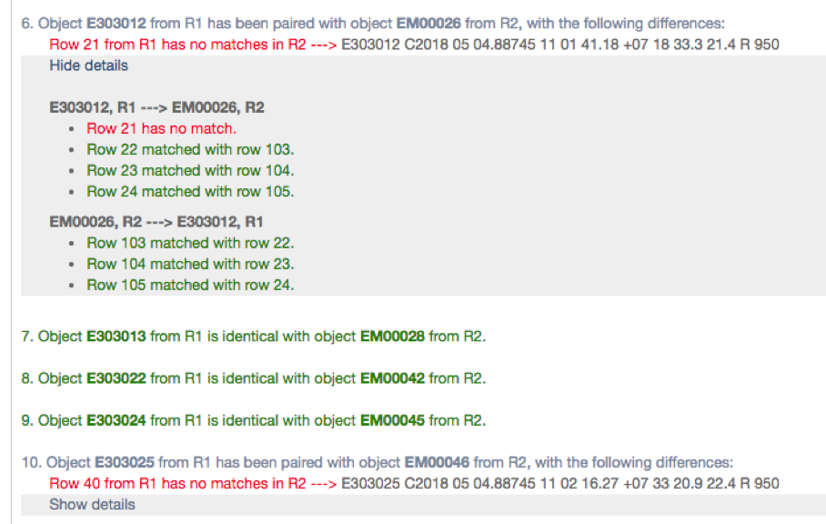
NEARBY Application – Report Matching

Slide 10

EURONEAR Project
The EUROpean Near Earth Asteroid Research
2006 at IMCCE Paris (Vaduvescu & Birlan). 40 members from 14 institutions from 8 EU countries and Chile
Increase the European contribution in NEA research using telescope network access (in Europe and Chile)
Achievements (www.euronear.org):
  Amelioration of 2000+ NEA orbits
  Statistics, discovery of 11 NEAs and pilot surveys
  Physical properties of 350 NEAs (lightcurves, spectroscopy, spectro-photometry)
  Software for planning observations, data reduction and data mining
  25 published papers (mostly ISI journals)
  More than 150 MPC/MPECs
  About 10 PhD theses related to EURONEAR and NEAs
  Citizen science, education and public outreach

Slide 11
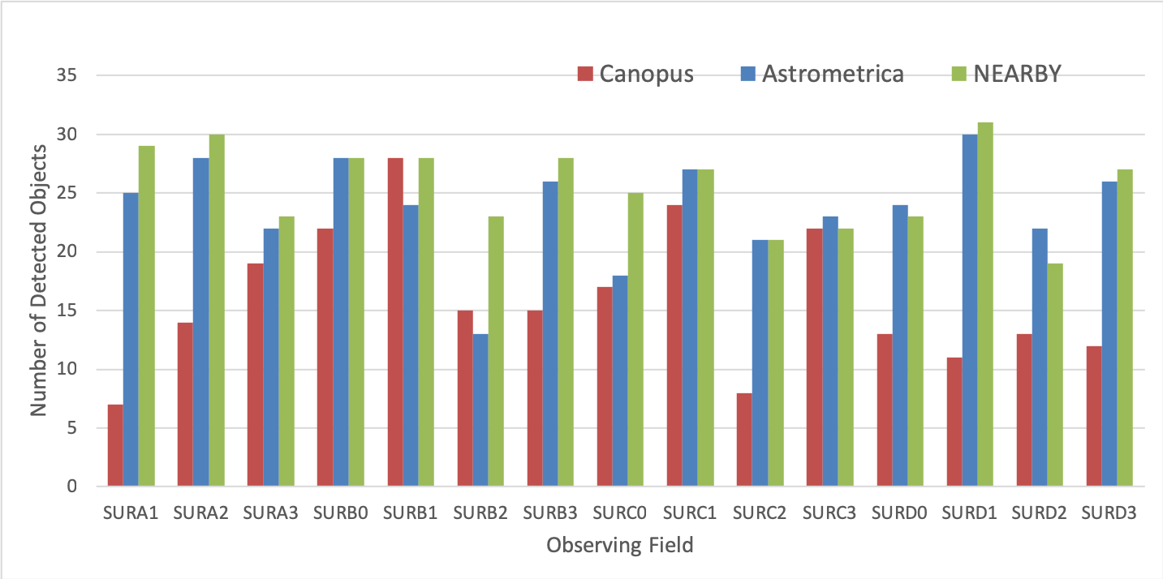
Nearby Experimental Validation
NEARBY detection rate compared with other software. 15 INT/WFC fields observed in Mar 2017 in the ecliptic in good time (dark, seeing ~1.5”). Overall NEARBY performs by 10% better than Astrometrica (automatic mode) and much better than MPO Canopus, but still remains under the human detection via careful blink (by about 10%, not plotted here).

Slide 12
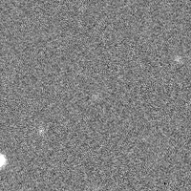
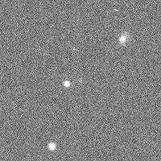
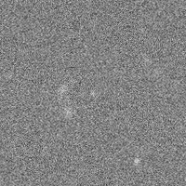
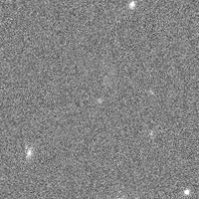
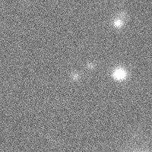
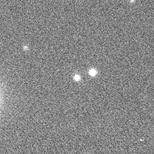
NEARBY – EURONEAR pilot surveys
NEARBY detection samples INT/WFC Nov 2018 mini-survey
Upper raw: faint (V~21-22) and variable seeing (1.5-2.5”)
Bottom raw: variable and very bad seeing (3-5”)

Slide 13
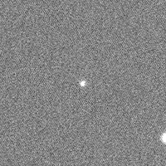
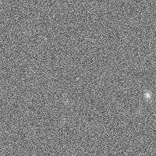
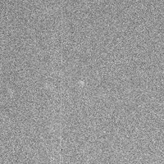
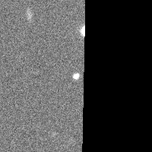
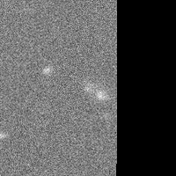
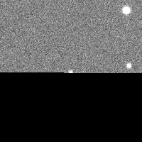
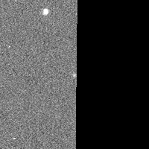
NEARBY – EURONEAR pilot surveys
NEARBY detection samples INT/WFC Nov 2018 mini-survey
Upper: Detection through random noise (happens rarely) or bright stars spikes
Lower: Detections close to CCD margins

Slide 14
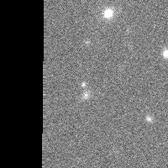
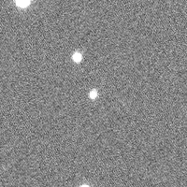
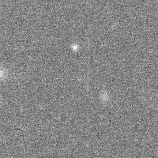
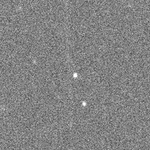
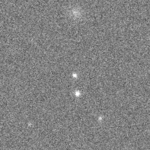
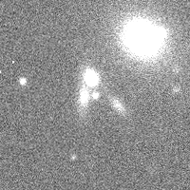
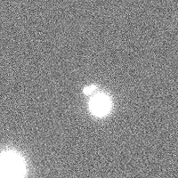
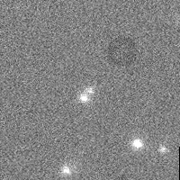
NEARBY – EURONEAR pilot surveys
NEARBY detection samples INT/WFC Nov 2018 mini-survey
Asteroids passing over stars or galaxies, sometimes in bad seeing

Slide 15
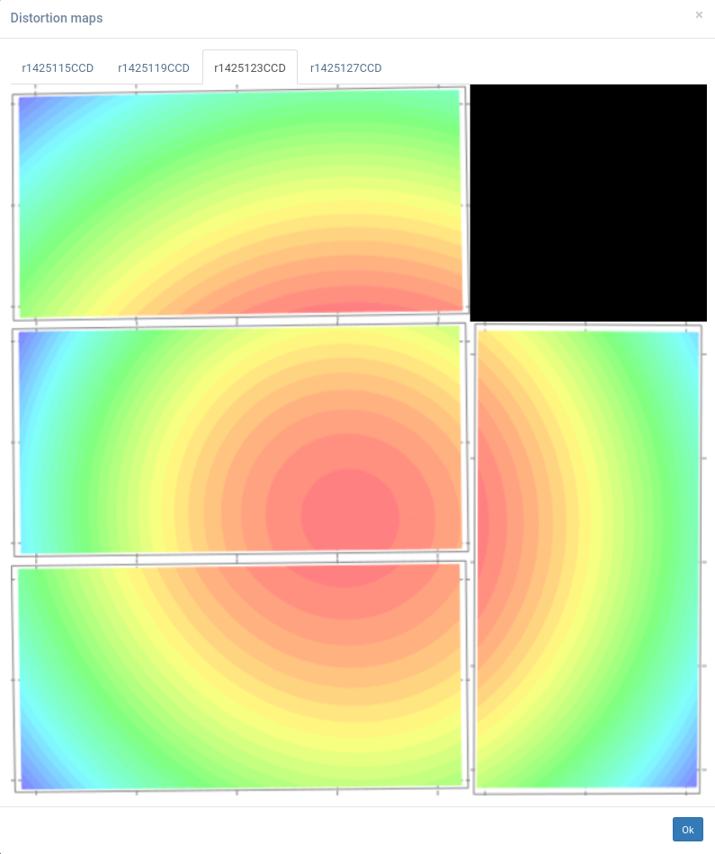
INT/WFC 4 CCDs Distortion
NEARBY QC – SCAMP distortion plots available for check by reducers
(INT/WFC 4 CCDs, one field 4 repetitions accessed from tabs above plot)

Slide 16
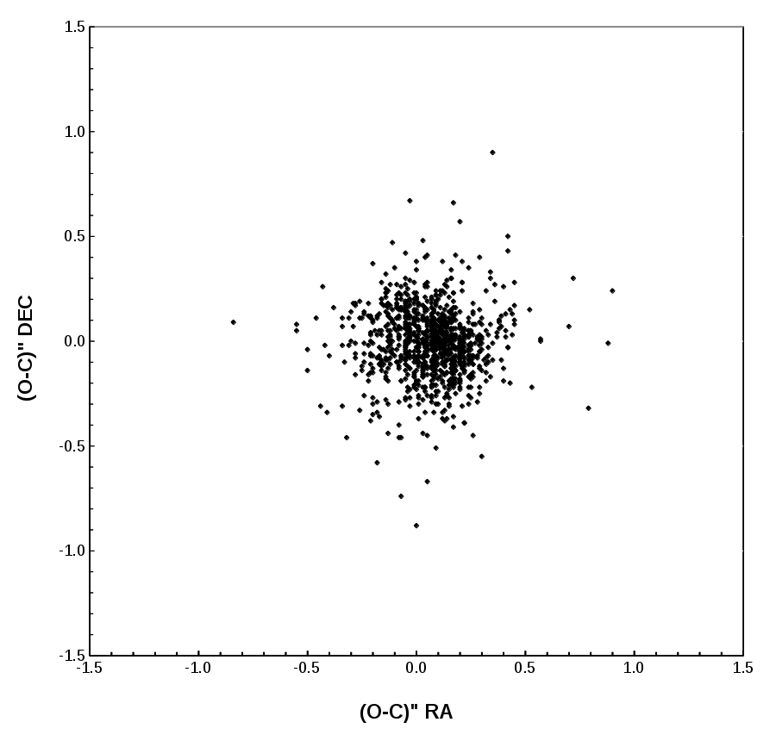
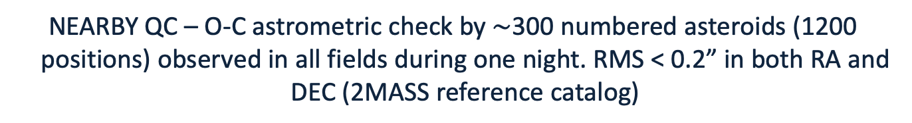
NEARBY QC – O-C Astrometric Check
NEARBY QC – O-C astrometric check by $\sim$300 numbered asteroids (1200 positions) observed in all fields during one night. RMS < 0.2” in both RA and DEC (2MASS reference catalog)

Slide 17
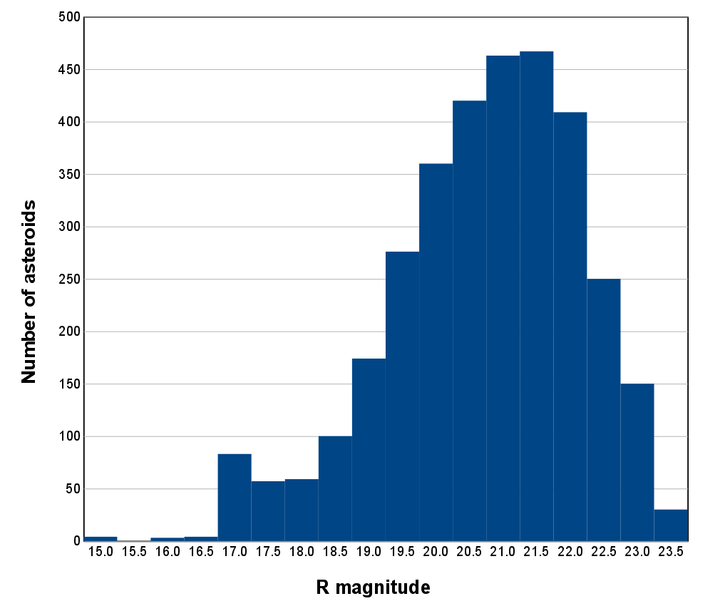
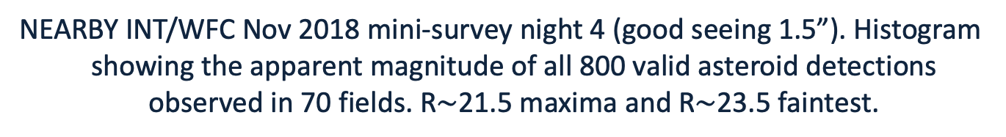
Apparent Magnitude
NEARBY INT/WFC Nov 2018 mini-survey night 4 (good seeing 1.5”). Histogram showing the apparent magnitude of all 800 valid asteroid detections observed in 70 fields. R$\sim$21.5 maxima and R$\sim$23.5 faintest.

Slide 18
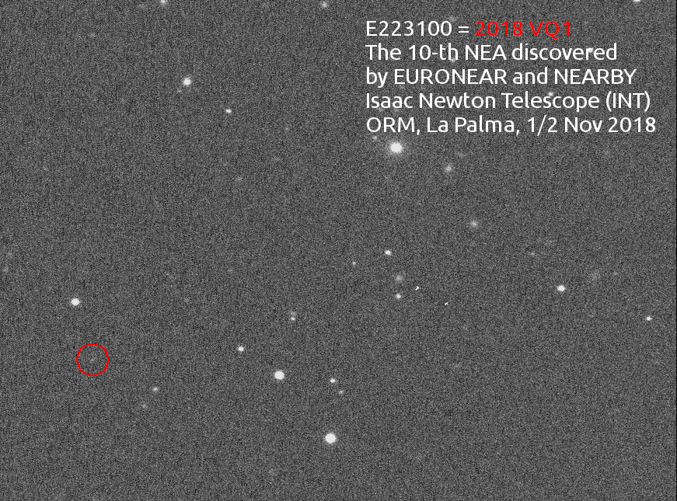
NEARBY – EURONEAR pilot surveys
NEA discovery using NEARBY reduction in relatively bad seeing. The faint trail was detected after careful human blink using Astrometrica (by Marcel Popescu)

Slide 19
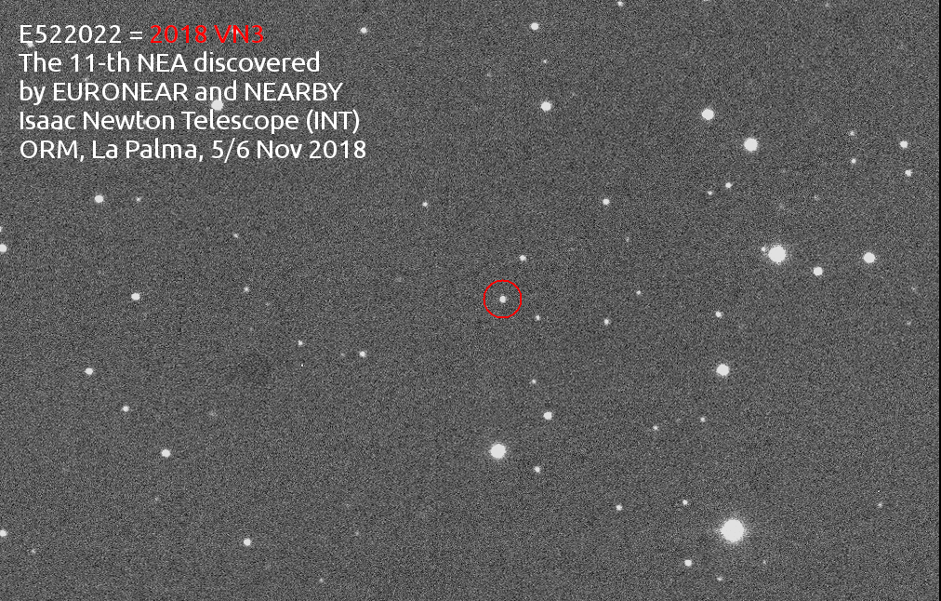
NEARBY – EURONEAR pilot surveys
NEA discovery using NEARBY reduction and detection (validated by Costin Boldea). We could report and recover both objects same nights within 2h!
Great thanks to recovery stations OGS, OSN, TLS when INT is not available!

Slide 20
Conclusions
NEARBY HPC infrastructure supports the INT/WFC real time computation of successive observation fields. It supports multiuser parallel processing
Automate detection of the moving objects is much more economical and 5 times faster than manual reduction
Automate detection covers all the possible detecting objects
Setting the parameters for high sensitivity infers noisy results and more false tracks
Projected low speed objects may be detected, but high noise and more false tracking are generated
Balance between the number of true object detections and the noise level should be determined for each particular observing conditions and the parameters are more tunable in NEARBY
NEARBY was tested in a few nights (few hours) and one pilot survey in Nov 2018 (5 nights) during which it discovered 2 NEAs which could be promptly recovered during the same night.

Slide 21
Many thanks for your attention!
ESA NEO and Debris Detection Conference - Exploiting Synergies
ESA/ESOC, Darmstadt, Germany, 22 - 24 January 2019
Dorian Gorgan¹, Ovidiu Vaduvescu²
¹Technical University of Cluj Napoca, Romania
²Isaac Newton Group, La Palma, Canary Islands, Spain;
Instituto de Astrofisica de Canarias, Tenerife, Canary Islands, Spain; University of Craiova, Romania
dorian.gorgan@cs.utcluj.ro; ovidiu.vaduvescu@gmail.com

